Slide 1
PRODML Distributed Acoustic Sensing (DAS)
Worked Example Tutorial (v1)
For PRODML v2.0

Slide 2
Overview
This presentation deck includes slides for the DAS worked example. For more information, see the PRODML Technical Usage Guide, which is included in the zip file when you download PRODML from the Energistics website.

Slide 3
DAS Fundamentals

Slide 4
DAS High-Level Block Diagram
Fiber Optic Cable
DAS Interrogator Unit
DAS
Processing
Well
Raw data
Terabytes
Processed data frequency band, spectrum, … Gigabytes, Mbytes
DAS data repository
DAS
Raw
DAS
Processed
Application 1
Application 2
Application 3

Slide 5
DAS High-Level Data Transfer
Field
Office
DAS data exchange
Transfer of calibrated raw data for further processing
Raw data storage
Raw data transfer
Main tasks
Planning and proposal
Project start up
Raw data collection
Near realtime extraction and processing
Extracted data visualization
Main tasks
Data processing
Data analysis
Data integration and interpretation
Archive relevant data
Destroy irrelevant data
Extracted data
Extracted data storage and transfer
Storage and transfer of real-time / near real-time extracted data for further data processing

Slide 6
DAS Nomenclature
Output Data Rate (=Number of Scans /Traces per second)
Decimated Output Data (Decimation Factor 4)
Measurement Start Time
Decimated Output Data (Decimation Factor 4)
Surface fiber Loci 0-4
Surface fiber Loci 0-4
0 1 2 3 4 5 6 7 8
Time
0
1
2
3
4
0
1
2
3
4
Locus Index
Well Head
DAS
Interrogation Unit
0 1 2 3 4
5
6
7
8
9
10
11
12
13
14
15
16
17
18
19
20
21
22
23
24
25
26
27
28
fiber length corresponding to a Locus
5
6
7
8
9
10
11
12
13
14
15
16
17
18
19
20
21
22
23
24
25
26
27
28
N
Start Locus Index
(for measurement)
Spatial Sampling Interval
Time Series for one Locus
…
Number of Loci = 17 (8 - 24) recorded
…
Casing
Locus Index
Production
tubing
Downhole fiber
Loci 5 - N
…
…
…
…
…
…
…
…
…
…
…
…
…
…
…
…
Production
packer
Perforated
Casing
section
N
Fiber End

Slide 7
DAS Detailed Data Transfer (1 of 2)
Field
DAS data exchange
Office
On site storage of calibrated acoustic traces (in external storage medium)
Transfer of calibrated raw data for further processing
DAS data life cycle
Raw data storage
Data transfer
Planning and proposal
Project start up
Raw data collection
Data quality assurance
Near real time data extraction / processing
Extracted data visualisation
Extracted data storage and transfer
Review application requirements
Review existing datasets
Determine if DAS acquisition would create additional value
Fiber deployment (if not installed)
Specify / agree on DAS data acquisition specifications
Data acquisition hardware mobilisation
Raw DAS data from interrogator unit
Depth calibration
Time calibration (if required)
Sensor calibration (if required)
Meta data population / instantiation
Real-time / near real-time data extraction (e.g.: Real time Frequency band extraction)
Data reduction
Visualise relevant information for real time / near real time decisions at well site support
Storage and transfer of real-time / near real-time extracted data for further data processing

Slide 8
DAS Detailed Data Transfer (2 of 2)
Field
Office
Select data traces to be archived as per company retention policy or for future R&D purposes
DAS data exchange
Manage raw data sets
Process and analyse raw data
Repurpose data if required and reprocess
Transfer of calibrated raw data for further processing
Destroy data that reached end-of-retention-period or unwanted data
Repurpose and reuse
Data transfer
Data pre-processing
Data analysis
Archive relevant data
Data destroy
Extracted data storage and transfer
Data processing
Data integration and interpretation
End of project
Storage and transfer of real-time / near real-time extracted data for further data processing
Further acoustic data processing
Integration of acoustic data with other data as required
Data and knowledge sharing

Slide 9
DAS Raw data
A
DAS Data Types
Time
Time
Fiber Distance
DAS Frequency Band data
Fiber Distance
Fiber Distance
B
Time
Sine wave exciting a channel displayed as a wiggle plot
Sine wave exciting a channel displayed using false colour for amplitude
Fiber Distance
DAS Spectrum data
C
Frequency
Frequency band that includes the frequency of the sine wave
Time
Spectrogram of the single channel including the sine wave
Frequency band that excludes the frequency of the sine wave

Slide 10
Distributed Acoustic Sensing (DAS)
How does it work (1)
Coherent OTDR
Coherent pulse propagates along the fiber
Tiny density fluctuations frozen into fiber during manufacture → act as scatter sites
Scattered light is captured and travels back toward detector
Detection time directly maps to location
Detected intensity is a function of the local properties of the waveguide

Slide 11
“Still” of Back Scattering

Slide 12
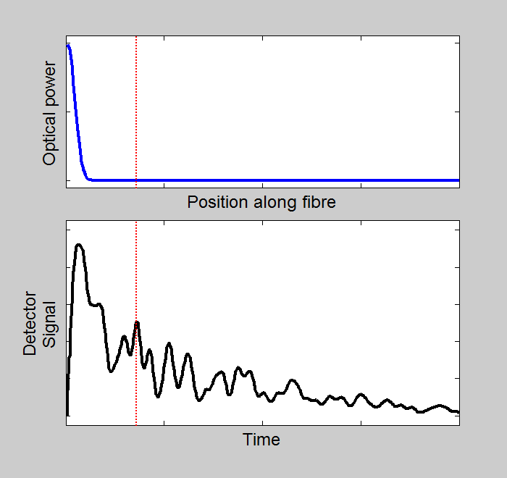
Distributed Acoustic Sensing (DAS)
How does it work (2)
Coherent scatter pattern remains constant on successive pings
Vibration from an acoustic source modulates the fiber and hence the scatter pattern
A history of the nature of acoustic source as a function of position may be determined

Slide 13
“Still” of Scattering Influenced by Sound

Slide 14
DAS Data Model

Slide 15
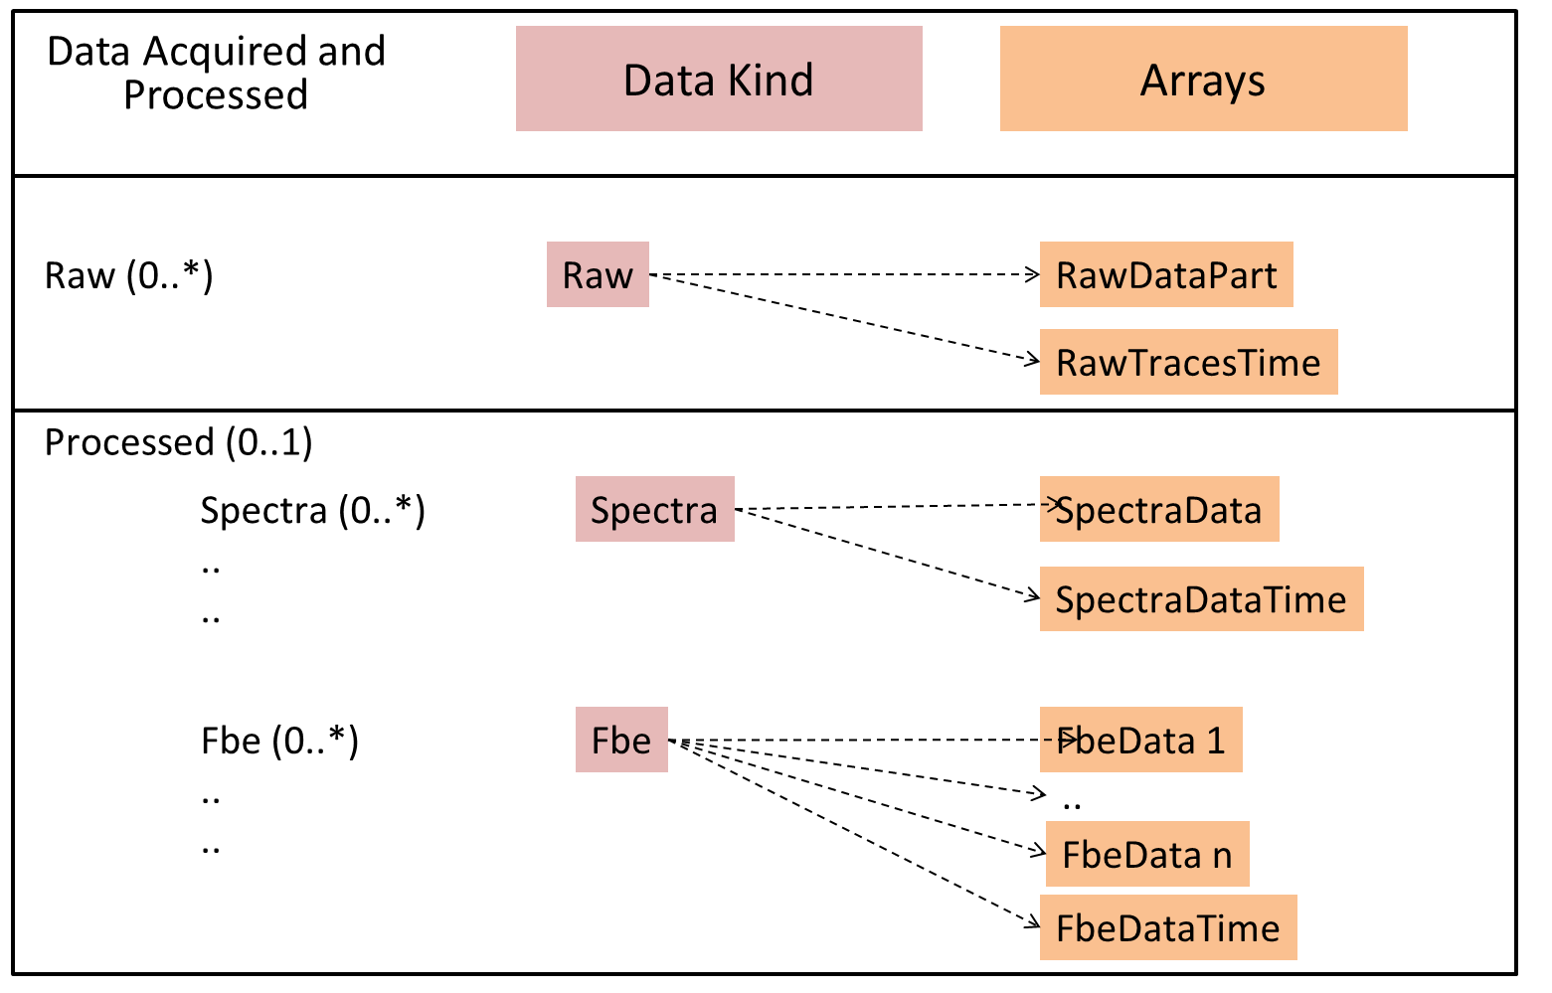
DAS Conceptual Model for Raw and Processed Arrays

Slide 16
DAS Possible HDF5 Array Configurations (1/2)
Arrays
Processed separate file
Processed with own raw
Hybrid
File 1..
File n
File n+1
File 1
File 2
File 1
File 2
RawDataPart
RawTracesTime
SpectraData
SpectraDataTime
FbeData 1
1
1
1
1
FbeData 2
2
2
2
2
FbeDataTime

Slide 17
DAS Possible HDF5 Array Configurations (2/2)
Arrays
Raw Only
Processed Only
File 1 …
File n
File 1
RawDataPart
RawTracesTime
SpectraData
SpectraDataTime
FbeData 1
1
FbeData 2
2
FbeDataTime

Slide 18
DAS Worked Example
Data Acquired and Processed
Array Data
Arrays
HDF5 Arrays
File 1
File 2
Raw
Raw
RawDataPart
RawTracesTime
Processed
Spectra 1
..
..
Spectra 1
SpectraData
SpectraDataTime
Fbe 1
..
..
Fbe 1
FbeData 1
1
FbeData 2
2
FbeDataTime

Slide 19
EPC: Energistics Packaging Conventions

Slide 20
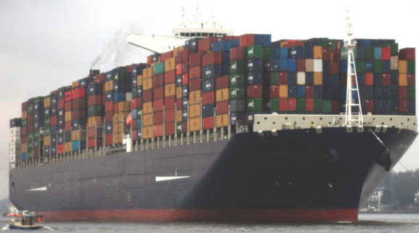
Optical Path
Instrument Box
EPC
EPC
Title : mytitle
Identifier : myUuidUrn
Creator : Energistics
…
DAS Acquisition
Raw Data
Processed Data: FBE
Processed Data: Spectrum
Raw DataY
Processed Data: FBE
Processed Data: Spectrum
Raw Data
Processed Data: FBE
Processed Data: Spectrum
Formatted using:
HDF5
(or other Energistics standard)
(or other Energistics standard)
All measurement data is stored externally to the EPC file, using HDF5, which is technology especially designed to handle huge data sets.
Notes:
Container ship photo from wikipedia : http://fr.wikipedia.org/wiki/Fichier:CMA_CGM_Marco_Polo_arriving_Port_of_Hamburg_-_16._01._2014.jpg
Licence : Creative Commons paternité – partage à l’identique 3.0 (non transposée)

Slide 21
Data Package is: EPC Container for XMLs, plus External HDF5 files with arrays of numbers
One EPC, 2 HDF5 files
H5 files contain data arrays
and are called External Parts
EPC is a zip file container
EPC File
XML Describes whole data set
XML Provides reference to External Part Reference (one per HDF5 file)
Rels folder
For each of the XML files, provides relationships to other files including external HDF5 files
Notes:
obj_Acquisition_uuid_xml: This XML describe the whole data set including parameters of Acquisition; Raw Data; Custom Data; Calibration and Processed Data, as well as their external references (if any)

Slide 22
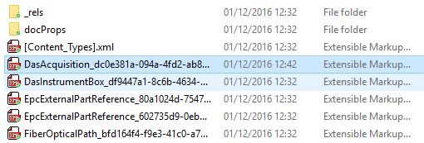
How Extenral Pat Reference Works
External Part Reference (EPR) is a proxy for HDF5 File
EPC File
DAS Acquisition File
Path in HDF5 File for an array
EPR for the HDF5 file containing the array
EPC External Part Reference File

Slide 23
Rels folder with .rels files
How External Parts Work
Part 2 - Rels files
This file (Das Acquisition XML) has relationship to
2 External Part Ref. files
+ optical path + instr box
This file (EPC External Part Ref. XML) has relationship to Das Acquisition and to one named external HDF5
Summary
From Das Acquisition the Raw can be split into 1..* arrays
Each split part has 1 EPC External Refs which allow navigation to the HDF5 file.
Each split part has its path within that file.
Summary
From Das Acquisition the Raw can be split into 1..* arrays
Each split part has 1 EPC External Refs which allow navigation to the HDF5 file.
Each split part has its path within that file.

Slide 24
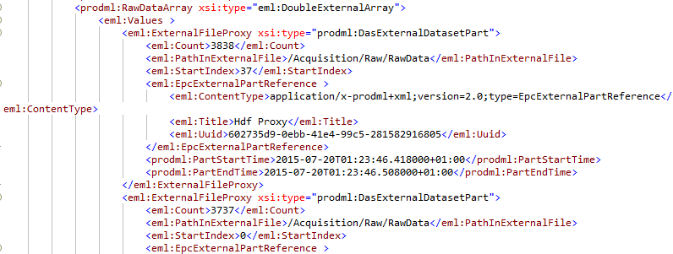
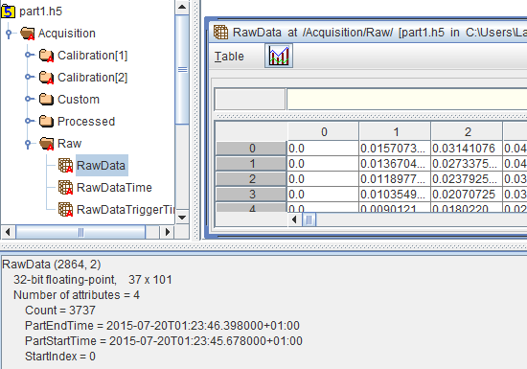
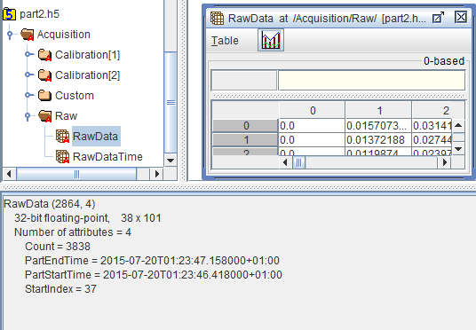
DasAcquisition File
Value arrays split across multiple HDF5 files showing path in HDF5 file and indices
Rels file for this ext part ref shows HDF5 file name
1st part
Part1.h5
2nd part
Part2.h5

Slide 25
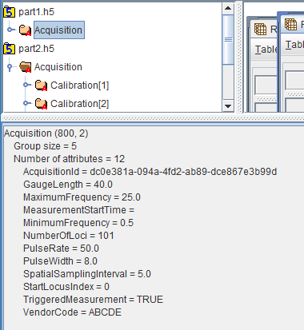
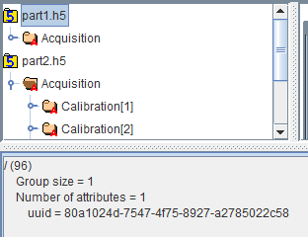
Keeping files associated in both directions
DAS Acquisition xml
HDF5 file
Every HDF5 Acquisition Group has attribute Acquisition ID. This is the uuid of the DAS Acquistion xml of which it is the data.
HDF5 file
Every HDF5 file has an attribute uuid. This should be used to store the uuid of the External Part Reference xml of which it is the data.
Ext Part Ref file

Slide 26
DAS Data Arrays

Slide 27
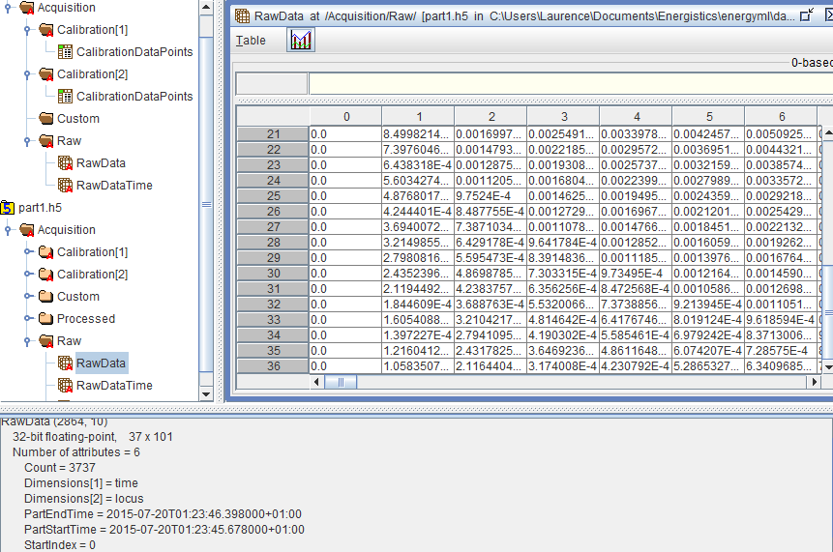
DAS raw data array values: 101 loci (horizontal 0-100), 37 samples (vertical 0-36) in h5 file part1.h5
Part2.h5 has the same loci and the samples continue in sequence, 38 samples (37-75)

Slide 28
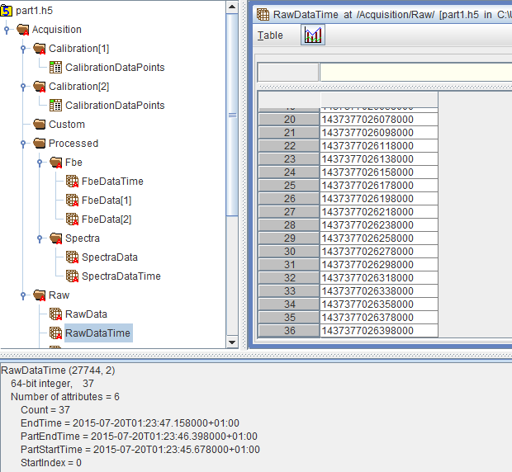
DAS raw trace times array and attributes in h5 file part1.h5

Slide 29
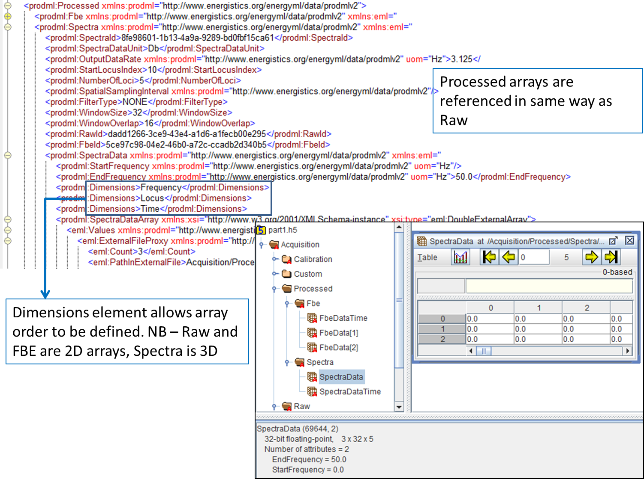
Processed Data

Slide 30
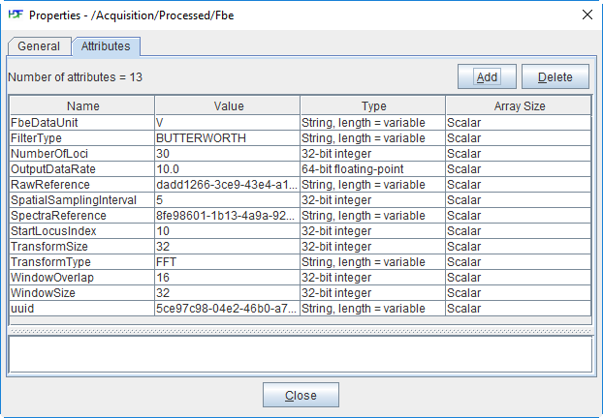
DAS FBE attributes h5 file part1.h5

Slide 31
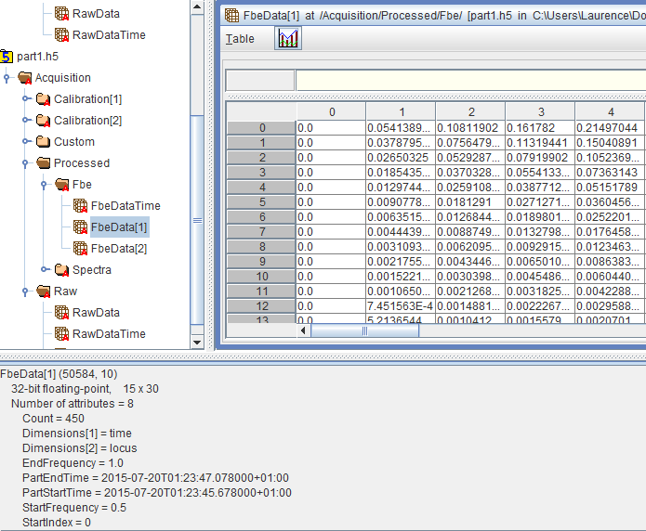
DAS FBE attributes and array values and for frequency band FbeData[1] in h5 file part1.h5

Slide 32
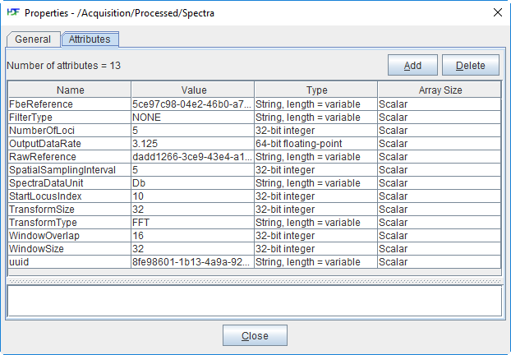
DAS Spectra data attributes

Slide 33
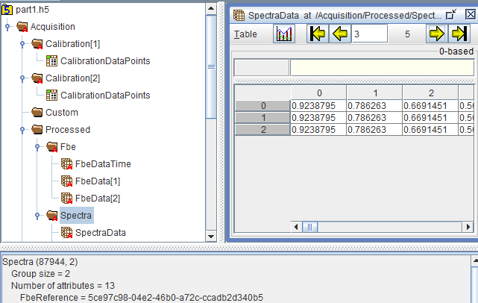
DAS FFT spectra for the spectra data array in h5 sample file part1.h5

Slide 34
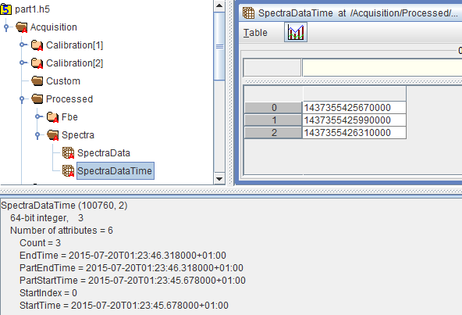
Spectra data time array and attributes in H5 sample file part1.h5

Slide 35
Optical Path

Slide 36
Optical Path
Describes all components through which light passes (fiber + other components)
Can span more than one wellbore
Provides mapping from path length to position in a facility (wellbore or pipeline)
Records defects that impact measurements
Conveyance
Shows changes versus time

Slide 37
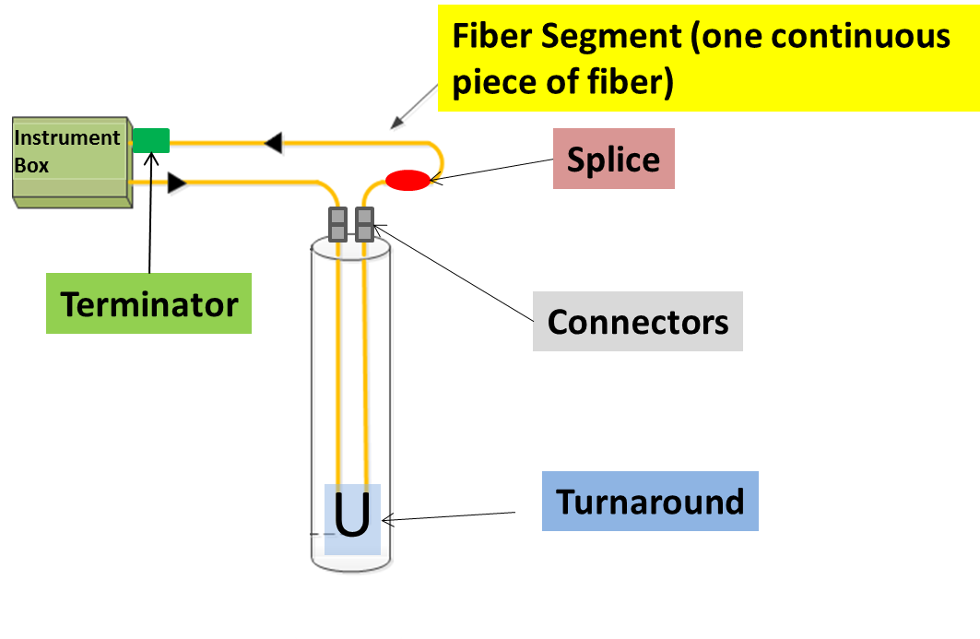
Optical Path Components

Slide 38
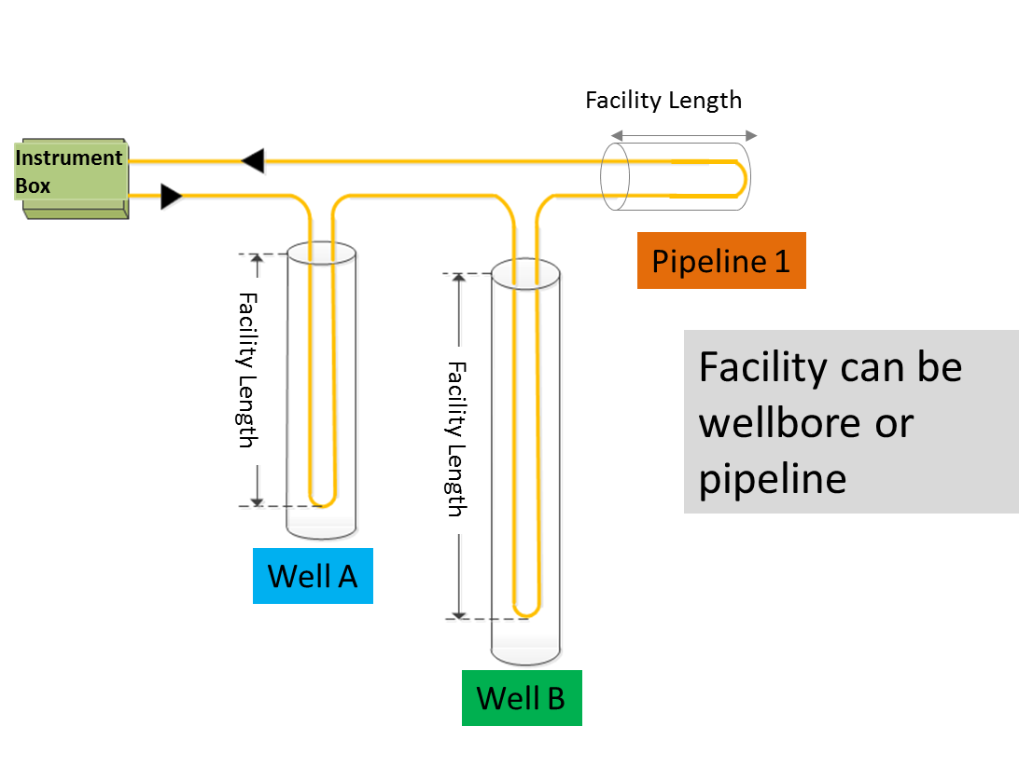
Optical Path can span multiple facilities

Slide 39
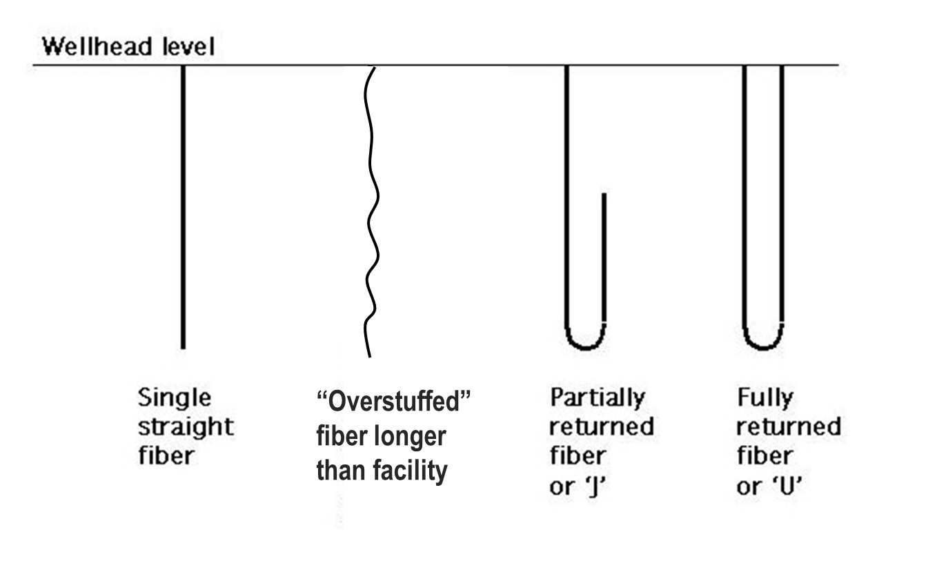
Fiber may be linear or “folded” along the facility (well, pipeline etc.) being measured

Slide 40
Optical Path Connectivity Representation
PRODML Network Representation
Network (represents the whole optical path)
Unit (represents each component)
Port (place where component connects)
Node (virtual point of connection)
Section illustrated
Ins. Box port
fiber segment 1
connector 1
fiber segment 2
Node a
Node b
Node…
Port 1
Port 2
Port 1
Port 2
Port 1
Port 2
First component (and terminator*) can name Instrument Box port connected
Each component is a “unit”
Each unit has 2 ports
Ports with a common “connected Node” are connected
Etc.
* - for double ended systems looped back to box

Slide 41
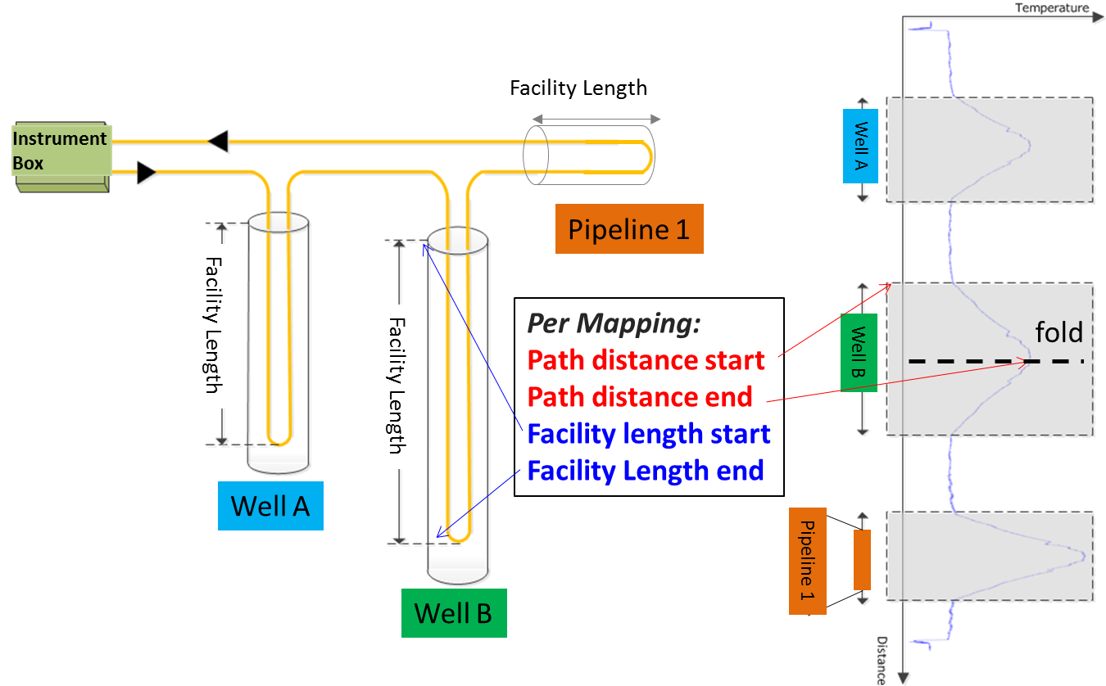
Fiber Facility Mapping links path distance to facility length, enabling facility “logs” to be made

Slide 42
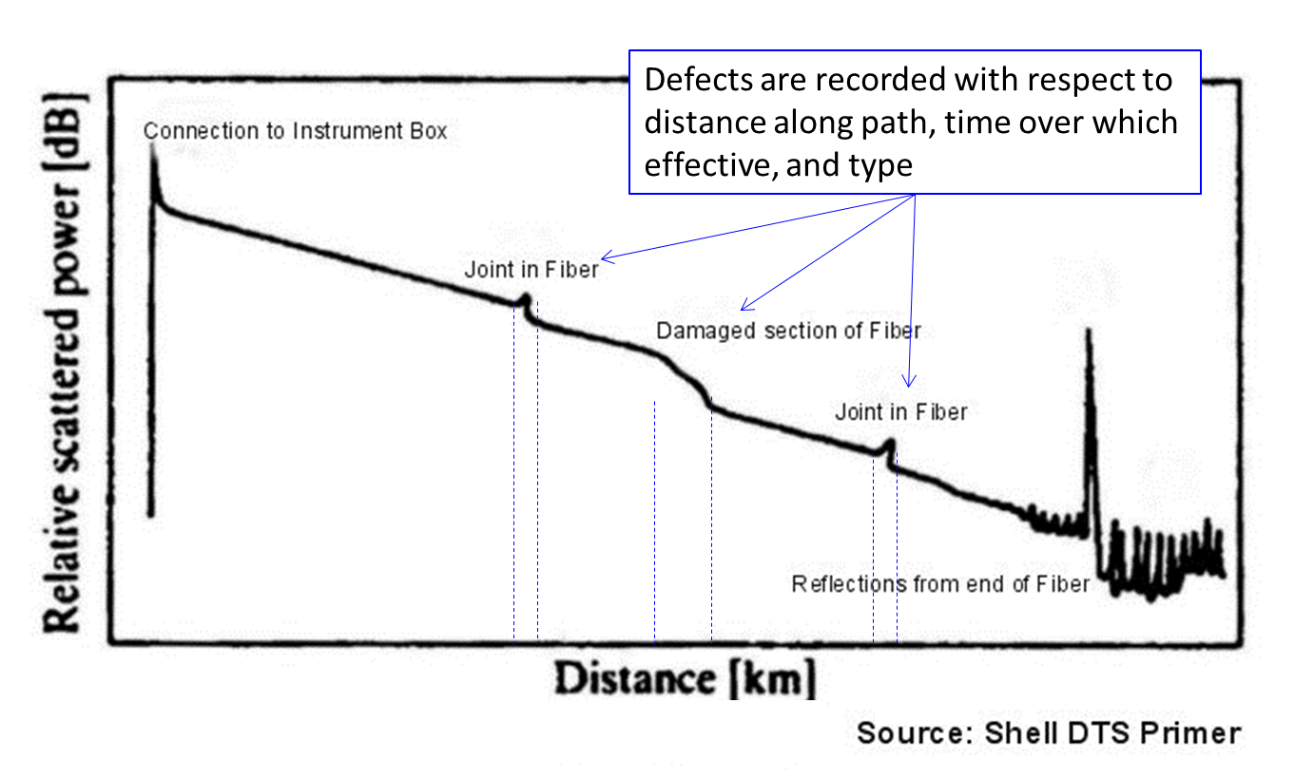
Fiber Defects recorded along Optical Path (Example data from OTDR test)

Slide 43
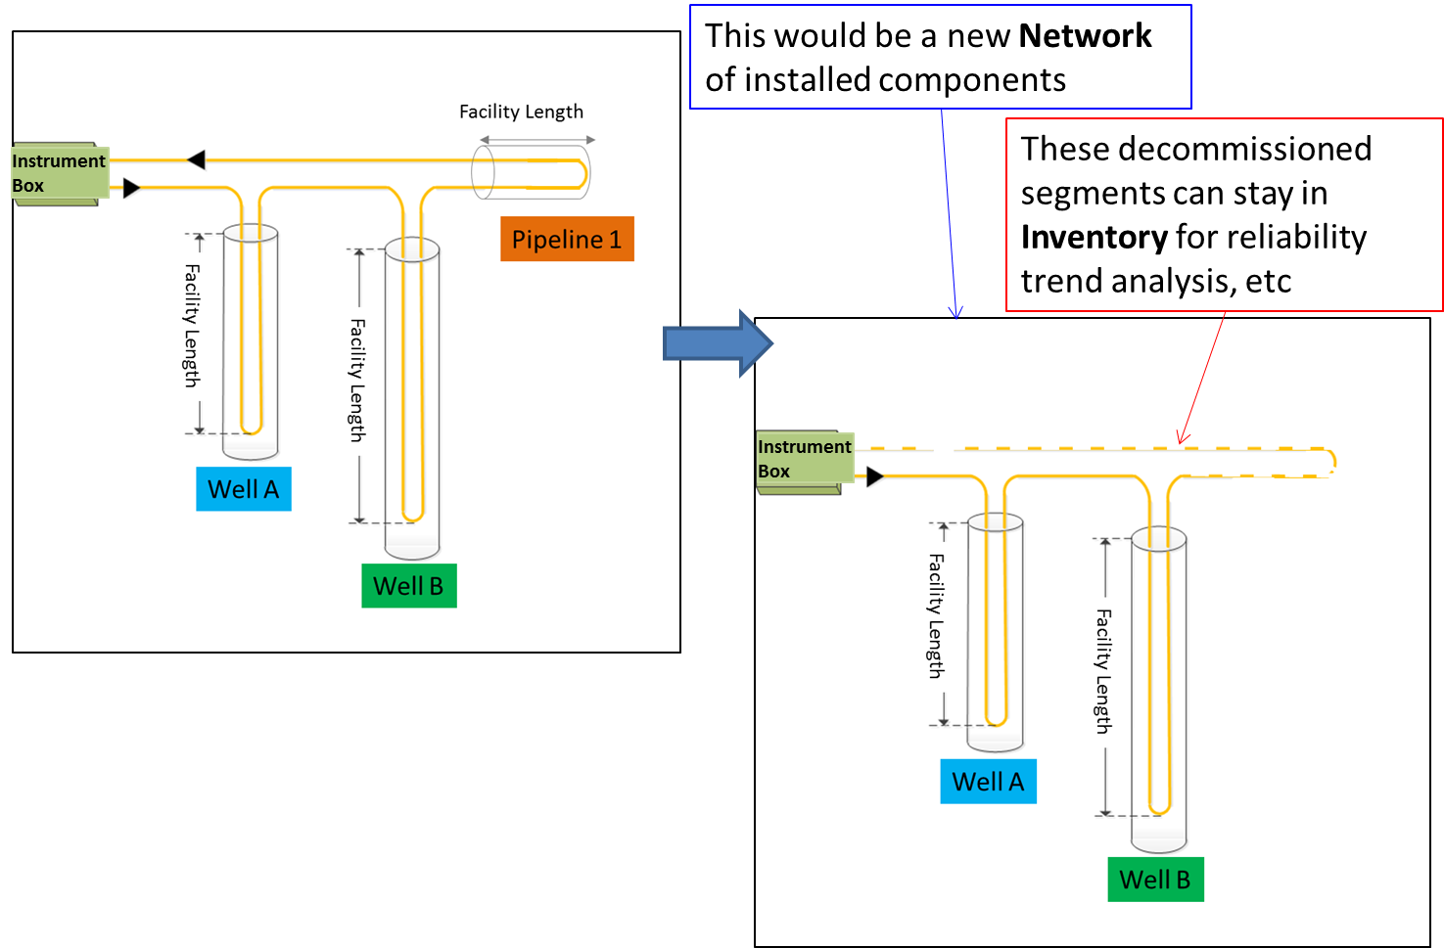
Optical Path may record changes over time: use of Inventory and Network allows for this

Slide 44
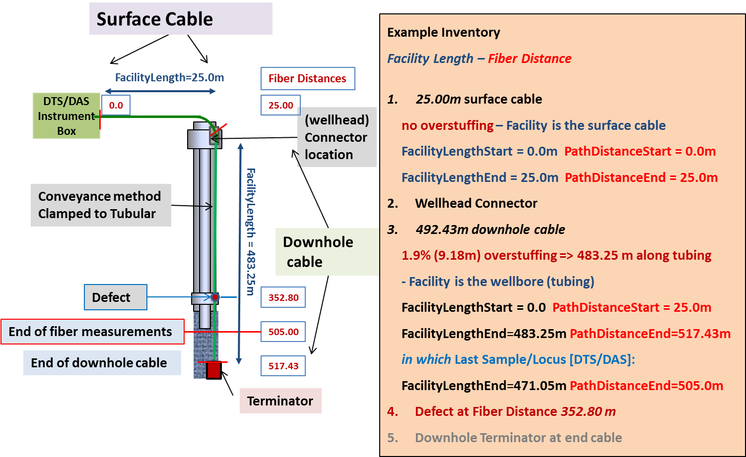
Simple Optical Path Example

Slide 45
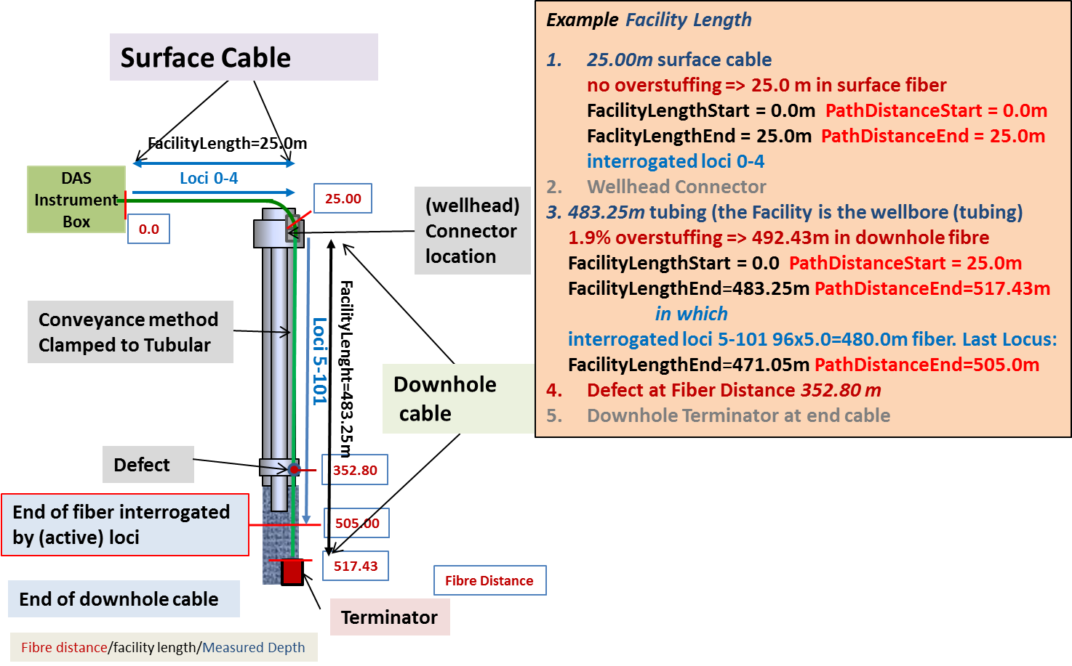
Simple Optical Path Example – 101 loci measurement

Slide 46
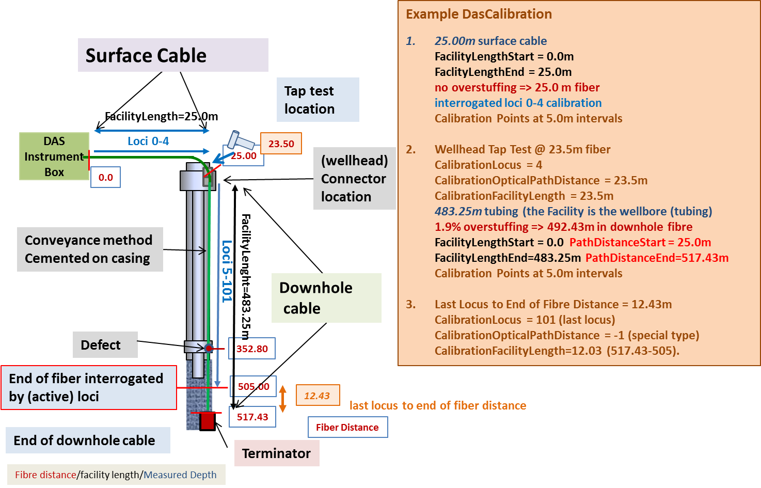
Simple Optical Path Example – 101 Loci Measured - Calibration

Slide 47
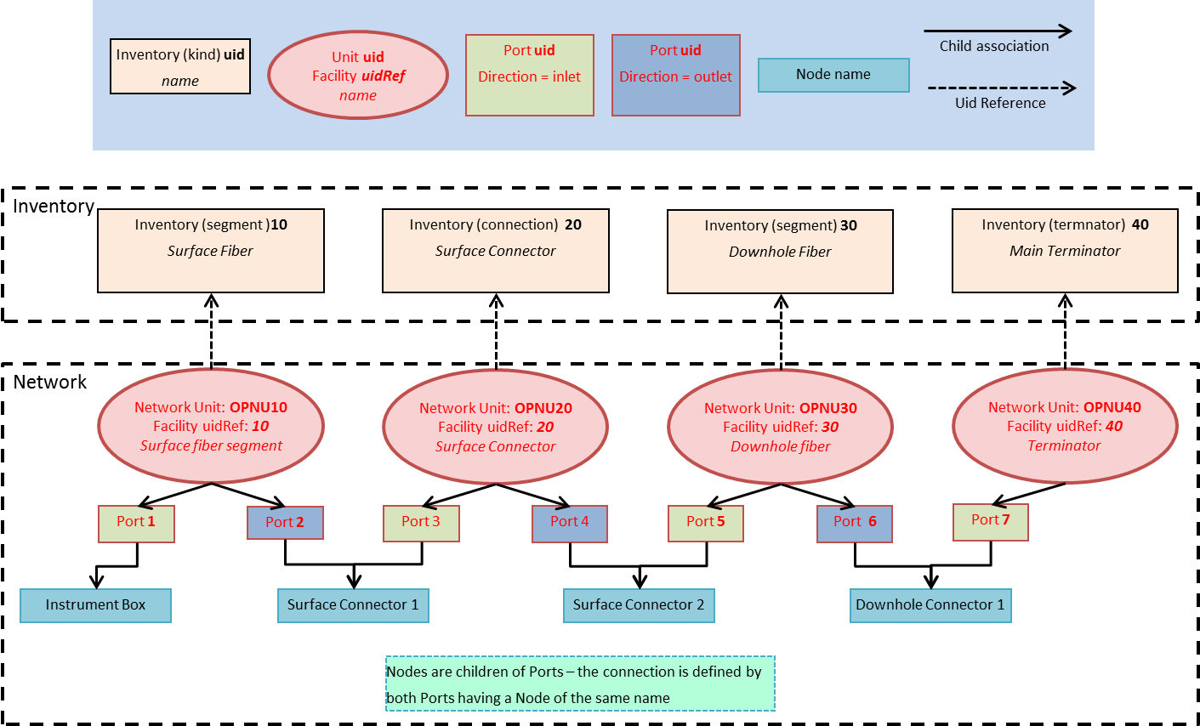
Optical Path example network showing connectivity

Slide 48
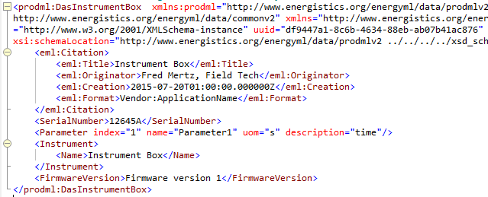
Instrument Box

